Slide 1

Amazon Product Review Analysis
Prepared by,
Saud Shaikh
Shakib Hussain
Sanchit Upadhyay
Under the guidance of
Dr Amit Kumar

Slide 2
Project Agenda
Business problem / Objective
Analysis
a. Data Preprocessing
b. Exploratory Data Analysis (EDA)
c. Text Preprocessing & Sentiment Analysis
d. Classification Models
Time Series Analysis
Recommendation

Slide 3
BUSINESS PROBLEM
Amazon has many product categories listed and to full fill its demand they must kept the product ready to shipped in their inventory the problem occurs when the products which are not highly in demand and covers the space in the limited inventory.
The business needs to optimize inventory management by identifying the product which will not be in demand in coming years and their storage should be paused.
OBJECTIVE
Predict categories that could be in demand based on the customer sentiments and sales.
Optimize inventory management by identifying the product categories based on the product sentiments.
Using time series models to predict the number of positive, negative or neutral reviews given by the customer after purchasing the product and doing future forecasting using historical data.

Slide 4
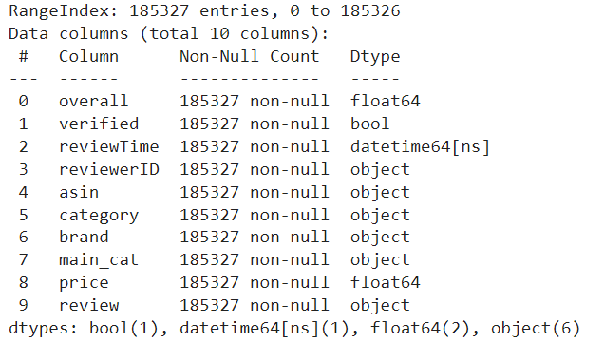
DATA PREPARATION
Merging of 5-core & Meta Data.
Searched for missing value and gave missing value treatment.
Searched for duplicate values in dataset and dropped.
Added new column review by merging review text + summary columns.

Slide 5

Exploratory Data Analysis (EDA)
5

Slide 6
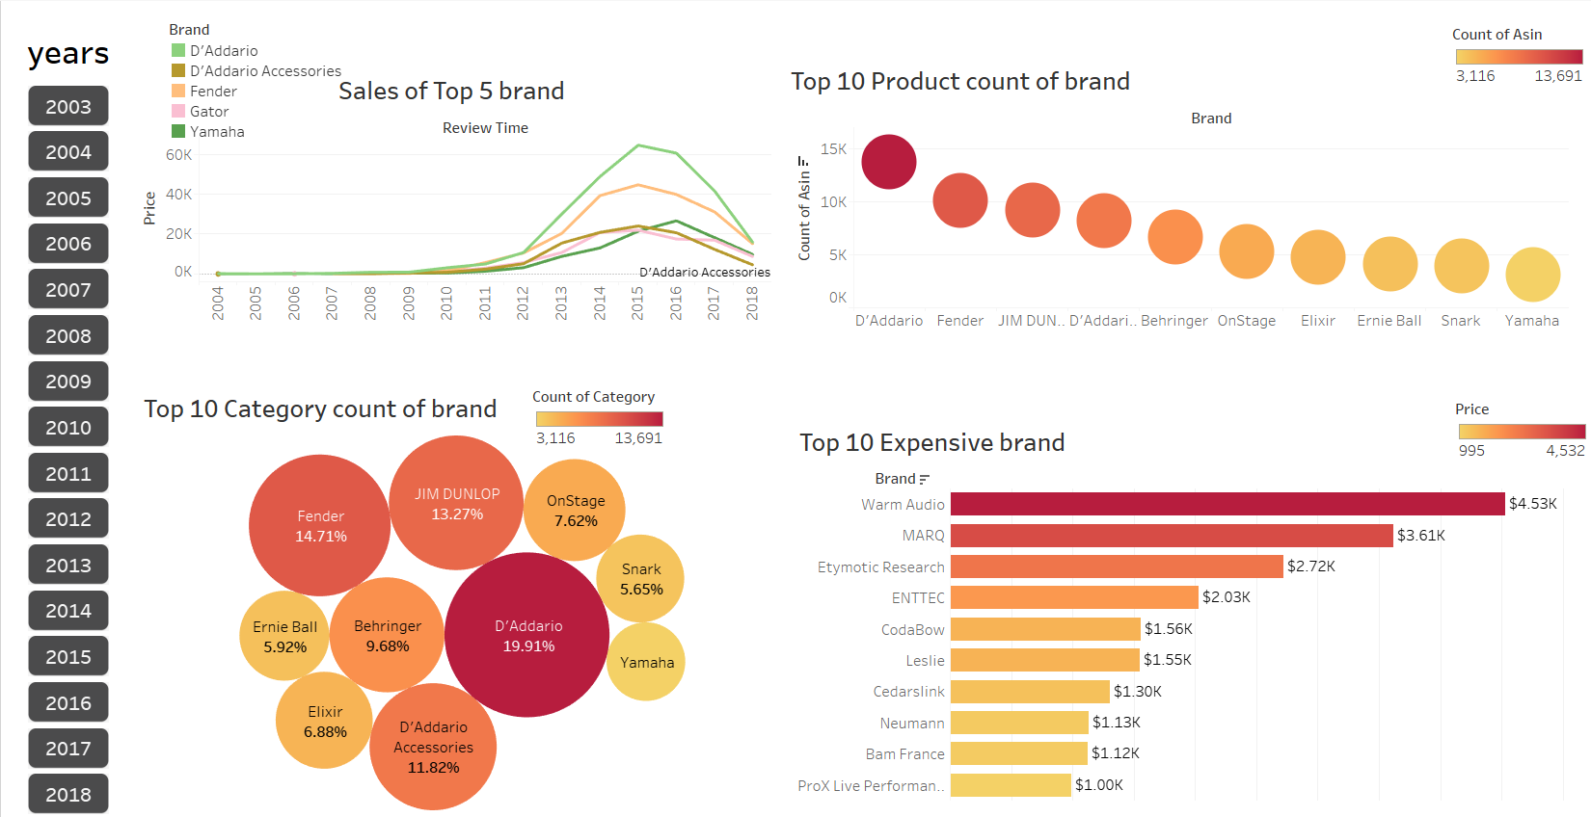
Top 10 Brand, product, categories and price
Conclusion
Brand D’Addario have the highest number of sales, Number of Product, Number of Categories and Overall(Rating).

Slide 7
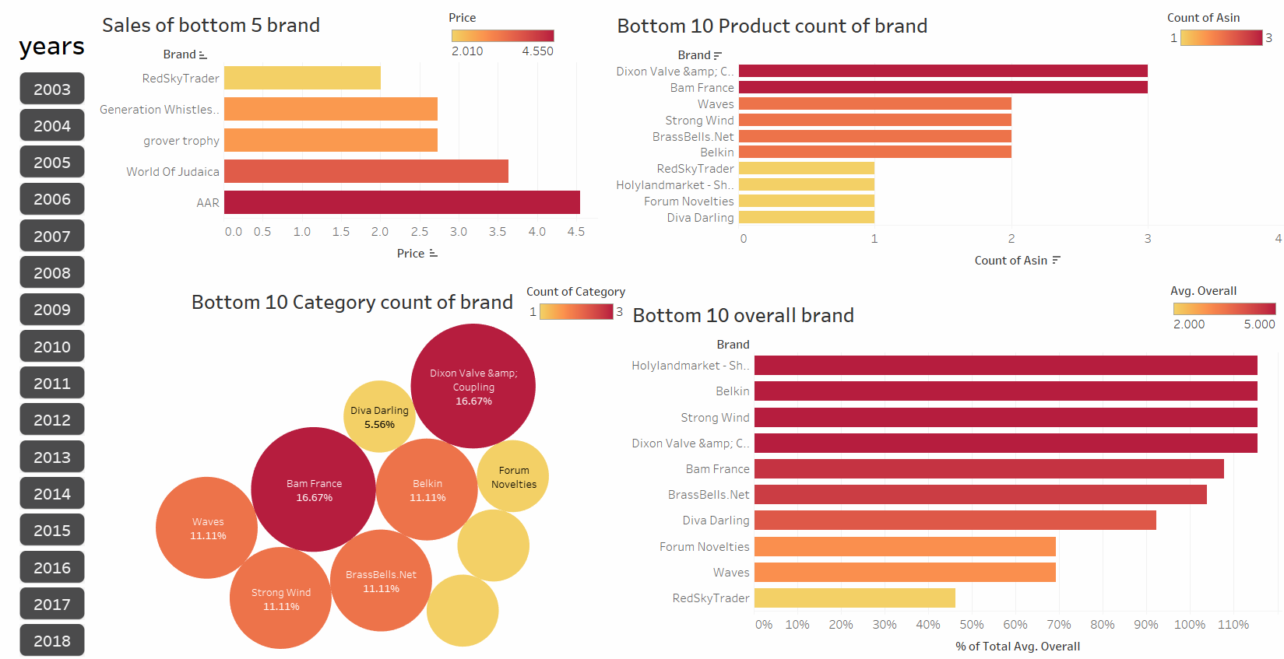
Bottom 10 Brand, product, categories and price
Conclusion
Brand RedSkyTrader, Holylandmarket, Forum Novelties and Diva Darling have lowest number of sales, Number of Product, Number of Categories and Overall(Rating).

Slide 8
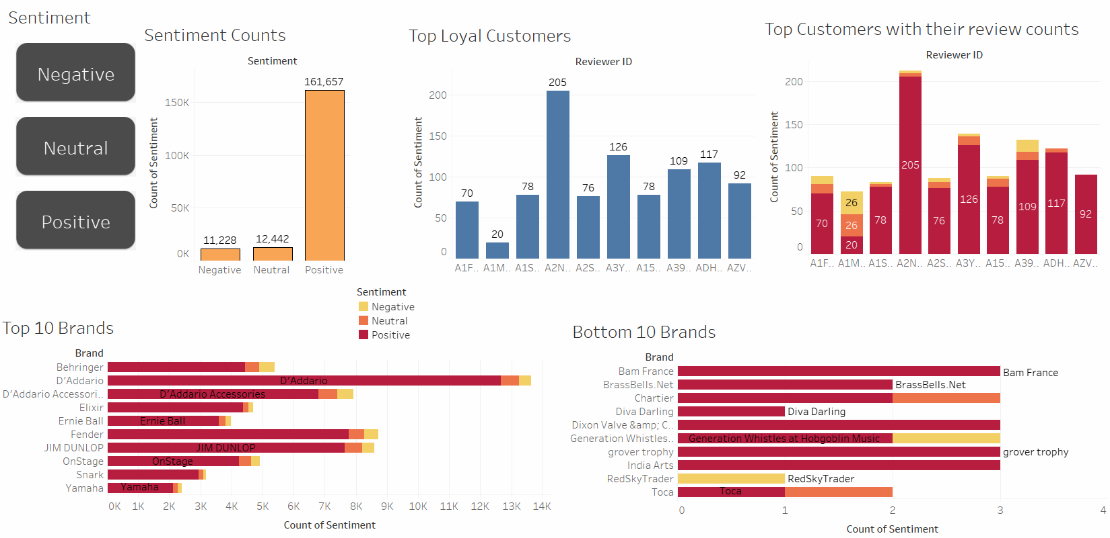
Top/Bottom Brand sentiment Analysis
Conclusion
Positive review have highest count and Brand D’Addario have the highest positive reviews.
Brand Diva Darling and Toca have the highest negative reviews

Slide 9
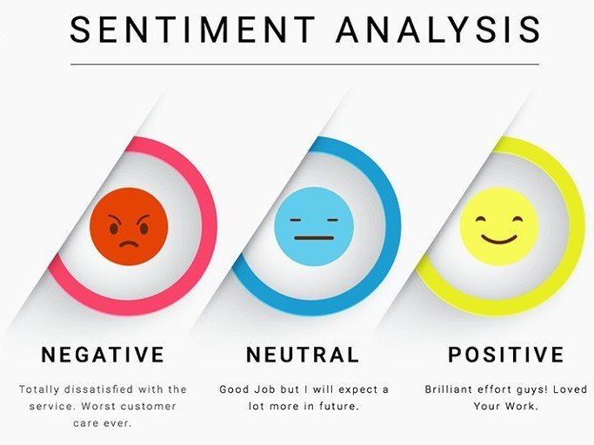
AIM :- To analyse the customer sentiments whether it is positive, negative or neutral.
9

Slide 10
TEXT PREPROCESSING & SENTIMENT ANALYSIS
Removing StopWords
Sentiment Prediction
Sentiment Labelling
Text Cleaning
Classification Modelling

Slide 11
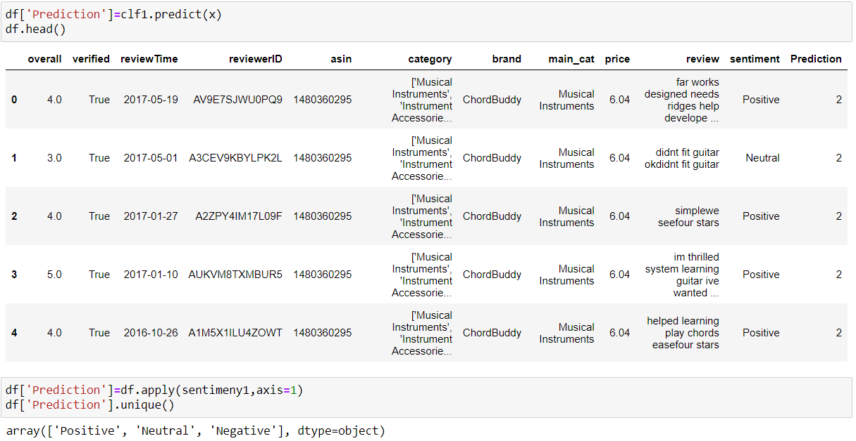
Sentiment Labelling
Defined a function for sentiment analysis
Overall >3 sentiment is Positive
Overall =3 sentiment is Neutral
Overall <3 sentiment is Negative
11

Slide 12
Classification Models
Models used for Classification
Multinomial Naive Bayes
Multinomial Naïve Bayes algorithm is a probabilistic learning method that is mostly used in NLP.
The algorithm is based on the Bayes theorem and predicts the bag of text
Logistic Regression
Logistic Regression is a statical method for predicting binary classes.
It computes the probability of an event
Decision Tree Classification Algorithm
A Decision tree is a flowchart-like tree Structure where we an internal node represents feature, the branch represents the outcome
AdaBoost Classifier
AdaBoost also called Adaptive Boosting is a technique in Machine Learning used as an Ensemble Method. The most common algorithm used with AdaBoost is decision trees with one level that means with Decision trees with only 1 splitt.

Slide 13
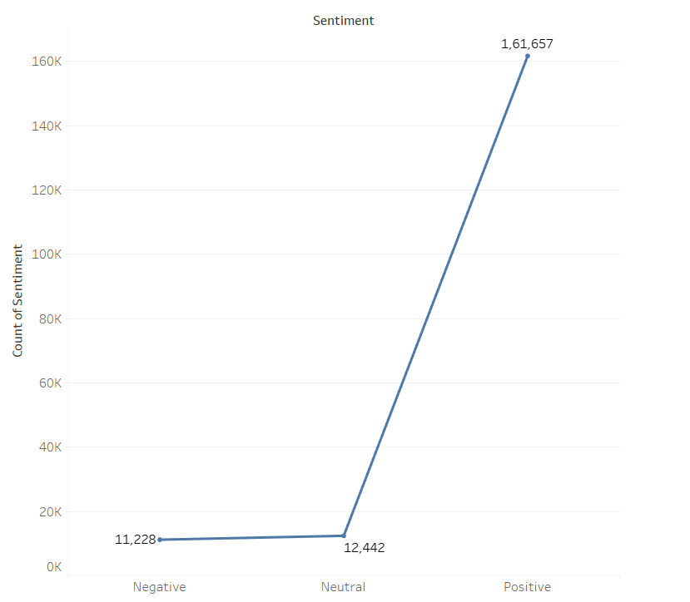
Balancing Data
SMOTE(Synthetic minority oversampling technique) function to balance the data.
SMOTE works by generating new instance from existing minority cases.

Slide 14
Comparing Classification Models
Applied SMOTE function on dataset.
Classification on review and sentiment columns.
Recommendation
Logistic Regression gives the highest values recall:0.9084829406427845 f1-score: 0.912935176131418 precision:0.9095375176588235 So, Model 2 is best fit model for our balanced DataSet.

Slide 15
Fitting our Model For Sentiment prediction
Added a new column named as sentiment where it have values in positive, neutral and negative
Defined function for Prediction where if overall rating < 3 Prediction is 0 if overall rating = 3 prediction is 1 and if overall rating > 3 prediction is 2.
Added new column based on sentiments as prediction

Slide 16
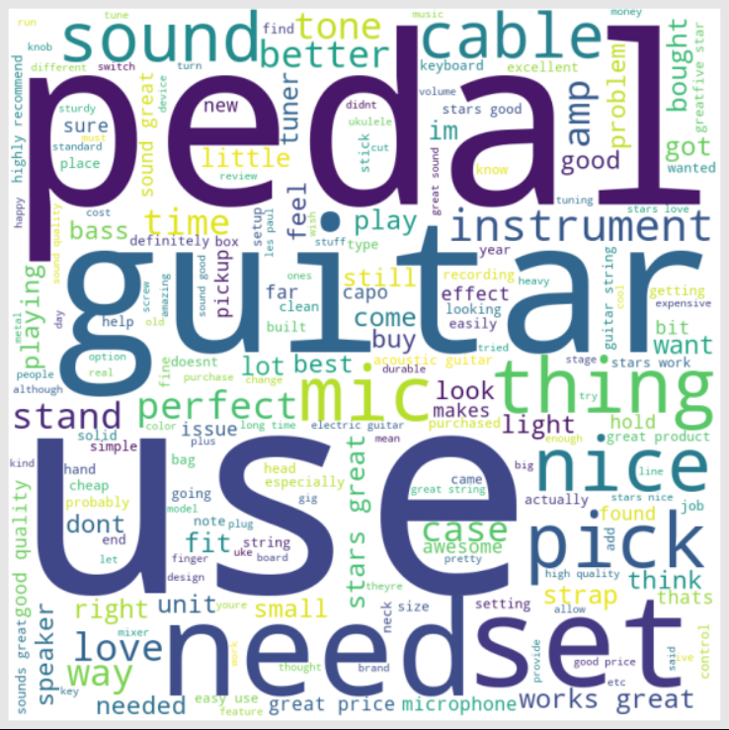
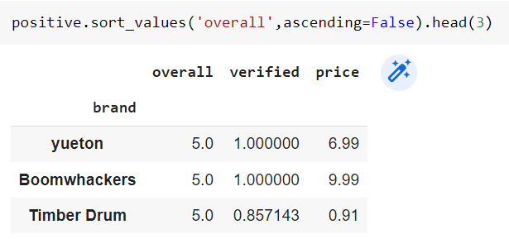
INFERENCE
Top 3 Brand with Positive Sentiment
Most Common Positive Review words

Slide 17
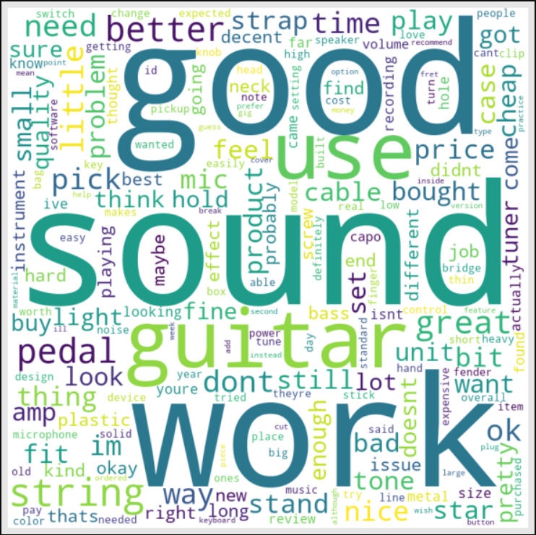
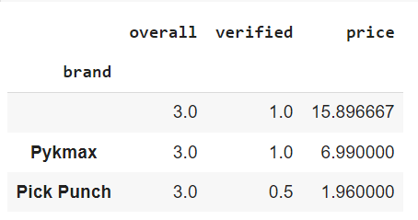
INFERENCE
Top 3 Brand with Neutral Sentiment
Most common words use for neutral reviews

Slide 18

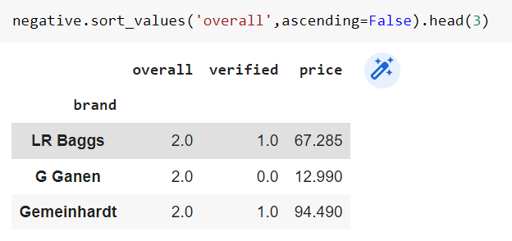
INFERENCE
Top 3 Brand with Negative Sentiment
Most common words use for Negative reviews

Slide 19
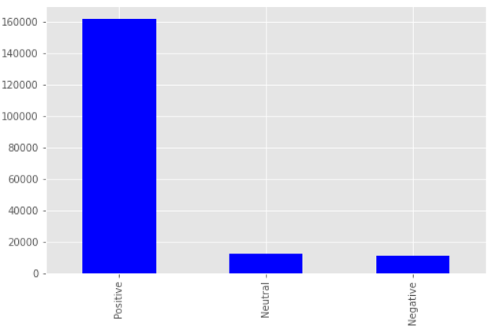
Time Series Analysis
AIM :-Time series analysis we are going to do forecasting the future sentiment of customer shopping in Amazon.
Splitting data in sentiment
Here taking only brand or overall rating for the forecasting the future prediction.

Slide 20
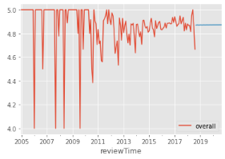
Positive Sentiment Forecasting
Here is our future prediction for 2 years and it indicates that the positive review will be constant. The positive rating would be near 4.9.

Slide 21
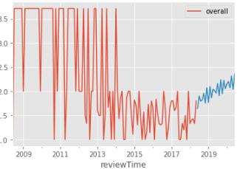
Negative Sentiment Forecasting
Here is our future prediction for 2 years and it indicates that the Negative review will increase.

Slide 22
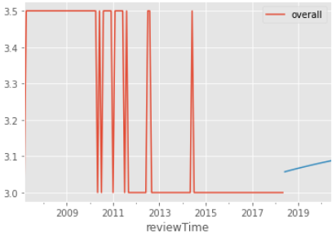
Neutral Sentiment Forecasting
Here is our future prediction for 2 years and it indicates that the Neutral review will increase over the period

Slide 23
Recommendation
As observed in future forecasting that the positive reviewed products will be having constant sales ,demand in the coming year 2019 & 2020
Neutral performing products is having good rating & average sale. Product can come in demand .for what we recommend to drop price ,increase durability.
The total sales for negative reviewed products will decrease in 2019 & 2020 with comparison to 2018 can be caused because of defaults like high prices, bad quality , less durability or not fulfilling the requirement of the customer. So, we suggest that we can optimize the inventory by managing these products by managing their production as there will be less sale and demand of these products in future

